Slide 1
Feature Importance Discussion
PLE/PLP Workgroup 6th August 2020

Slide 2
Introductions
Any new members?

Slide 3
Summary of Current PLP Feature Importance
PLP currently uses variable importance in scikit-learn or coefficients – this is not great and may use different methods
Classifier | Variable importance
Random Forest/AdaBoost/Decision Tree | Gini Importance – for a predictor, for each split involving the predictor sum improvement that the split makes weighted by how many data-points are in the split. Improvement is variable’s impurity measure before split minus weighted impurity measure after split.
Gradient Boosting Machines | Gain –the relative contribution of the corresponding feature to the model calculated by taking each feature's contribution for each tree in the model. A higher value of this metric when compared to another feature implies it is more important for generating a prediction.
LASSO logistic regression | Coefficients – the weight assigned to the variable in the model (requires variables to have an equal scale)
KNN | None
Deep Learning | None

Slide 4
Current Feature Importance Not Based on Model
We also use basic measure of association between predictor and outcome: standardized mean difference
This does not depend on a specific model

Slide 5
Common Feature Importance
Potential other methods commonly used:
Permutation feature importance (based on the decrease in model performance)
SHAP (based on magnitude of feature attributions)
This are both based on the trained model rather than the data

Slide 6
Permutation feature importance (PFI)
First, a model is fit on the dataset, such as a model that does not support native feature importance scores. Then the model is used to make predictions on a dataset, although the values of a feature (column) in the dataset are scrambled. This is repeated for each feature in the dataset. Then this whole process is repeated 3, 5, 10 or more times. The result is a mean importance score for each input feature (and distribution of scores given the repeats).
This approach can be used for regression or classification and requires that a performance metric be chosen as the basis of the importance score, such as the mean squared error for regression and accuracy for classification.

Slide 7
Illustration
Feature 1 | Feature 2 | Feature 3 | Feature 4 | Feature 5 | Outcome
1 | 0 | 0 | 0 | 0 | 1
1 | 1 | 0 | 0 | 1 | 0
0 | 0 | 0 | 0 | 1 | 0
0 | 0 | 0 | 0 | 0 | 0
0 | 0 | 1 | 0 | 1 | 1
Original data
AUC = 0.70
Feature 1 | Feature 2 | Feature 3 | Feature 4 | Feature 5 | Outcome
0 | 0 | 0 | 0 | 0 | 1
0 | 1 | 0 | 0 | 1 | 0
0 | 0 | 0 | 0 | 1 | 0
1 | 0 | 0 | 0 | 0 | 0
1 | 0 | 1 | 0 | 1 | 1
Feature 1 permuted data
AUC = 0.68
Feature 1 PFI = 0.70-0.68 = 0.02

Slide 8
PFI Example Plot

Slide 9
PFI Pros/Cons
Pros | Cons
Fairly Quick – just permute data per predictor then apply model and calculate AUC (or other metric) decrease | Model specific – with our data correlated variables may not be selected due to the other variable being picked – we won’t know importance of these
Model agnostic– can be applied for any classifier (including KNN) | May not account for data correlations (we permute variables individually which may not be realistic)
Can focus on AUC | Global importance only
Confidence intervals possible | Slow if large number of features

Slide 10
SHAP (SHapley Additive exPlanations)
Based on game theory
Looks at the contribution of a model’s feature for each patient (local interpretability)
Global importance also possible by averaging across patients
Contribution is based on shapley value – this is the total impact of a feature when considering all combinations of other features

Slide 11
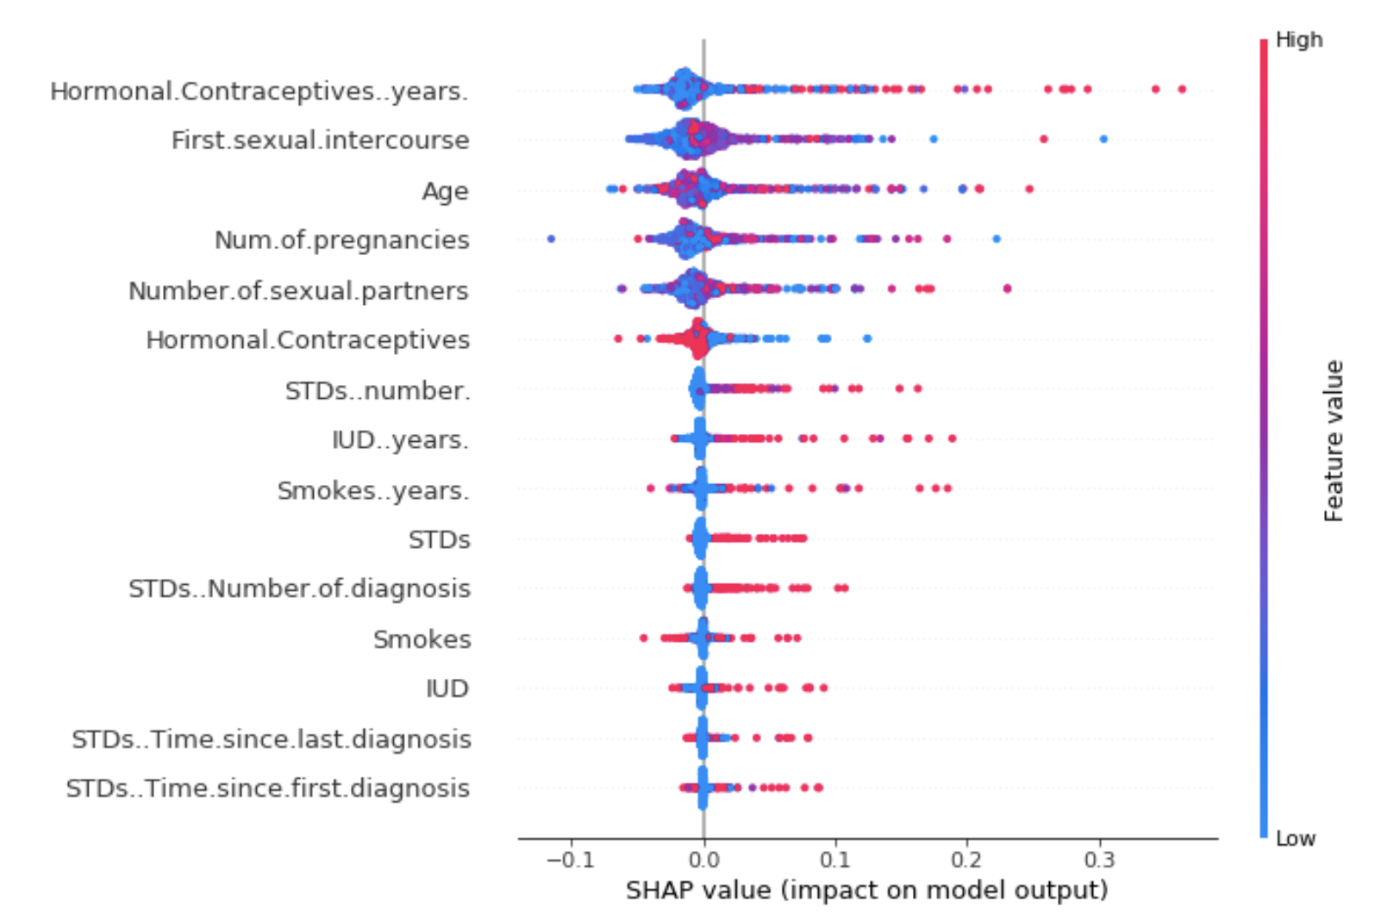
Example SHAP
Example from internet – the nice thing about SHAP is that you get the impact of the feature per patient so we can plot distributions of importance

Slide 12
SHAP Pros/Cons
Pros | Cons
Local importance | Model specific – with our data correlated variables may not be selected due to the other variable being picked – we won’t know importance of these
Model agnostic– can be applied for any classifier (including KNN) | May not account for data correlations (if a variable is missing then imputes which may be unrealistic)
Can show positive/negative contribution | Not sure how well it scales

Slide 13
Other methods
Partial importance (PI)
Individual conditional importance (ICI) plots
Partial dependence (PD)
Individual conditional expectation (ICE) plots
LIME (estimate complex model with simple interpretable model – e.g., linear model)
LOCO (like PFI but refits model – too computational)
Plus plenty more…

Slide 14
Current work
I’ve started to add PFI – I’m doing in in parallel to speed things up https://github.com/OHDSI/PatientLevelPrediction/blob/development/R/FeatureImportance.R
But before focusing on this…

Slide 15
10 min group discussion
1. Should we focus on feature importance – what are the use cases in PLE and PLP?
2. Any other useful methods we should consider?
3. What method/s should we focus on (if any)

Slide 16
10 min research collaboration ideas
Shall we do an OHDSI network study into feature importance?
What things are important to assess? (speed, interpretability, …)

Slide 17
If we have time…
Any ideas to improve our clinical application publication chance?

